Slide 1
Prospecting - Doing it Right 物色人选 – 做对了！
Stephanie Ng
Supervising Coordinator

Slide 2
Prospecting 物色人选
“The original meaning of prospecting is the search for mineral deposits or gold mining.”
物色人选的由来是从采金矿中寻找矿物质。
In this case, prospectors are people who search for gold, identifying places where it can be found. Once discovered, they sit by the river and check mounds of dirt for just a few specks of gold.
真正物色人选这个字眼的由来是从采矿者而引发，通常采矿者们都会辨认哪个地势会有金属。确认后，他们就会坐在河流旁，从一堆泥土中寻出斑点的黄金。

Slide 3
What is Prospecting
什么是物色人选
Like mining, we network/socialize to expose ourselves to get to know people. Through conversations, experiences and building the relationship we find that GOLD.
The art of prospecting is the art of making friends with a skill of identifying they want in life.
如采矿者，我们必须多广阔我们的朋友圈子，或透过社交群体，从中累计挑选的经验，建立自己所要物色的群体后，找到属于我们自己要的《人选》，这就是真正的《物色人选》。

Slide 4
PROSPECTING IS NOT AN EVENT! IT IS A PROCESS Prospecting + WHY = Coffee Meeting 物色人选不是一个《项目》、 而是一个《过程》 物色 + 他人的梦想 = 约会

Slide 5
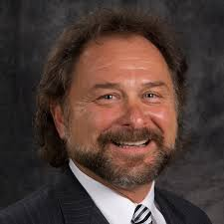
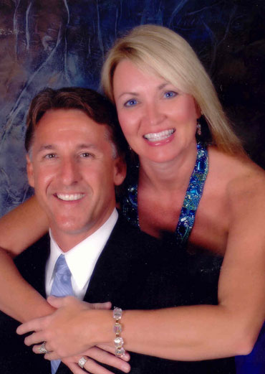
Concept of Prospecting 物色人选的概念
POSSIBLITIES 潜在人选
Build Social Currency. Increase Net worth by increasing social Currency. Keep Building Friends and sorting as you go along.
尽量列出你所有的名单，每天不断的添新名单。
RECRUITING招募
Friend / Family
亲戚 / 朋友
Networking
网际
KEEP THE FUNNE FULL!
把这个《物色人选的斗子》挤满
PROSPECTING
物色人选
Social Media
社交群体
Work
职场同事
Through the process, and the sorting process the “nuts” will appear.
从名单中再经过过滤挑选出《最优秀的种子》。
The NUTS 《优秀种子》

Slide 6
Out of 1095 People = How many will ask you what you do? 在1095 天内，有多少人会问您，《您从事什么工作》？
1 Day 第一天 = Meet for Coffee 约喝咖啡
1 Week 第一周 = 7 Coffee Meeting 7 天的咖啡约会
4 Weeks 第四周 = 28 Coffee Meeting 28 天的咖啡约会
1 Year 第一年 = 365 Coffee Meeting 365 天的咖啡约会
3 Year 第三年 = 1095 Coffee Meeting 1095 天的咖啡约会

Slide 7
Needs & Skillset of a Good Prospector 物色人选必备的技能
Appearance and Mannerism 外观和举止
Posture 姿态
What is it? / What do you do? / Your Why
这是什么？您从事什么工作？您的梦想是什么？
Business card 名片
Website 网站
Database List to update 新的数据库
Professional Appointment Setter 约会专家

Slide 8
If you do it Right………..!
POSSIBLITIES ARE EVERYWHERE
如果您做得对 ………！
到处都有可能性的名单

Slide 9
Appearance and Mannerism 外观和举止
Appearance 外观
How we look creates an impression and an opinion when someone meets us
How we like someone to view our business is how we should dress.
Dress appropriate to the event.
我们的穿着会给人留下深刻的印象及对我们的看法，因此，在不同的场合，穿恰当的服装是非常重要
Mannerism 举止
Our actions matters
Be polite
Be courteous and aware of surroundings
Culture and Ethics plays a part
Show Respect is important
我们要注意仪态、礼貌、还有四周的环境及尊重他人的道德文化

Slide 11
Dress Code 著装规范

Slide 12
Tips on Prospecting 物色人选的提示
Dress appropriate to the environment 穿合适的服装参加活动
Come with a SMILE 用最亲切的容貌出席活动
Topic of discussion is NEVER YOU! 从不用《自己》成为他人讨论的话题
Know about them ONLY! 把焦点放在的《对方》的身上
Objective:
FIND OUT WHAT THEY WANT
GIVE THEM WHAT THEY WANT BY BEING THE PROBLEM SOLVER
LET THEM LEAD YOU TO THEIR PEOPLE
目的：
寻出他们的需求
借用我们商业的平台来符合他们的需求
接力于他们的人脉
Set the Appointment 设定约会

Slide 13
Conversational Marketing 对话营销
Smile. Be Friendly 友善、微笑
Build a Connection 建立友情桥梁
Find some common ground that you have either similar interest or connection or things you do.
寻找投机的话题，如嗜好、同等认识的朋友、现今社会所发生的事件等等。
LISTEN 聆听
Let them talk - NOT YOU! Use power words to keep them going like “wow!”, “Really ?”, “You got to be kidding me?”, “Awesome”.
让对方多发言 – 而不是《你》！但，你也不要保持沉默，可以用恰当的字眼跟进，如：“哇！”，“真的吗？”，“您在开我的玩笑吧！”“太有趣了！”
Gather information. Use FORM + THEME or FORMHD
你可以用 FORM + 主题 或 FORMHD 的方式来收集他人的资料
F: FAMILY 家庭 O: Occupation 工作 R: Recreation 娱乐 M: Money 经济
THEME 主题 : Backup Plan 后备计划, Health 健康状况, Dreams 梦想, Tax 税率, Brokerage 产品代理商的概念等等 ..
4. Open Mind 开放对方的心态
Use concept like : Golden Goose/Cash Flow Quadrant to help them see 可以采用概念式的对话，如：时间及财务自由的概念来开导对方或启发他的想象力
SOMETIMES – the conversation doesn’t lead you to an opening. When you do #3 and #4
It is OK! Keep the contact. May not be the right time or right individual or you may need to build up a relationship.
有时候虽然你已经按照以上的 #3 和 #4，但是显然还是不能够启发对方开放的心态，别放弃！可能是天时、地理和人和都还不对时，没关系，保持联系就好！

Slide 14
Conversational Marketing 对话营销
5.
5. Approach: 方法
Use this only if you feel like saying or introduce a product or the business…
若你要介绍对方一样产品或与他分享事业模式，你可以采用这个方法…
Step 1: Do you keep your options open? (wait and listen)
您保持选择的立场吗？（聆听、等候）
If YES – goto step 2 若对方答“愿意”，那回去第 2 步骤
If NO – Change topic and move on 若对方答“不愿意”，那就转换话题，继续寻找下一个目标
Step 2 第 2 步骤
If I can show you a way…(prospect challenge)…. Is there any reason why you won’t …(try the product/get more information)….如果我可以与您分享一个行得通的方法，有什么理由您会拒绝我介绍您… (询问后，介绍产品）
If I can show you a way …(prospect challenge)… Would YOU.…(try the product/get more information)…
如果我可以与您分享一个行得通的方法，您愿意给自己一个机会吗？
6. Next Step 下一个步骤
Set the Appoint 设定邀约
Set a time to call or meet for coffee 安排时间会面

Slide 15
Be Ready to Answer 一定要准备充分的答案
“What DO YOU DO?” “您从事什么工作？”
“What is it?”“这是什么创业机会？”

Slide 16
Power Statement 强力宣言
WHAT DO YOU DO ? 您从事什么工作？
I’m a _____ and I own _____
我是一名_____，同时我也拥有_____
Example 举例
I’m a teacher and I own an online franchise.
我是一名教师，同时我也是拥有自己的电子商务平台

Slide 17
Purpose! 目的！
Have their interest? 惹起对方的好奇心！
When they are asking too many questions, it is time to set the appointment.
当他们问起很多问题时，便是安排会面的好时机。
“Everything else is hard to explain, can we get together? Which day works better for you, Monday or Tuesday?”
“现在很难用三言两语说明一切，我们可以找个时间坐下来详谈，下周一或周二，哪一天的时间比较合适您呢？”

Slide 18
Example of What do you do “您从事什么工作”的举例
I teach people how to make a lot of money online
我常教人怎样在电子商务的平台上赚很多钱。 – Liz Webber
I help people create an ageless lifestyle with wellness solution.
我常与人分享保健的心德，教人怎样保养、冻龄。 – Jacki Blasko
I teach people how to make a lot of money online with a new concept call the UnFranchise.
我常与人分享怎样接力于我的连锁平台，赚更多的钱。 – Jim Winkler

Slide 19
Power Statement 强力宣言
WHAT IS IT? 这是什么创业机会？
COMPANY ANSWER 公司标准回答
A GLOBAL PRODUCT BROKERAGE AND INTERNET MARKETING COMPANY THAT SPECIALISES IN ONE-TO-ONE MARKETING
我们是一家产品代理及网际网路行销 公司，专门从事一对一行销

Slide 20
Example of WHAT IS IT? “这是什么创业机会”的举例
It’s a way to make a lot of money online.
是一个平台能让人们从网际网路中赚很多钱的商机。 – Liz Webber
It’s a product brokerage and internet marketing company that helps people turn their spending into earning and create shopping annuity.
是一家产品代理及网际网路行销公司，帮助人们转消费为收入，因而创造了购物年金的概念 – Jacki Blasko
It’s call the Shopping Annuity, Have you heard of it? Basically I help people take money they already spending on every day stuff and turn it into an investment that pays them on an ongoing basis.
这个我们称为购物年金，您有听过吗？ 基本上是接力于转变人们每天的消费， 成为一种投资，因而从中创出永续收入。 – Colton Whited
We are really a hybrid between franchising and internet marketing and traditional business. We take the best of each to create an entirely new concept called the UnFranchise.
我们的平台滚和了连锁、网际网路行销及传统业务，从中再寻找出最佳的概念称为“超连锁”平台。 – Jim Winlkler
Have you ever heard of the Shopping Annuity? It’s a way of taking the dollars you are already spending and putting them into an investment for yourself. I can’t believe you have never heard of it.
您有听过购物年金吗？其实就是用您所花出去的钱，找回投资的路，让它再回到您的裤带里。真的不敢相信您没有听说过。 – Ke and Joe Gerard

Slide 21
YOUR WHY 您加入的原因
2 Minute Commercial 两分钟广告
This is a testimonial of the real reason WHY you are doing this business accompanied by an appealing description of the business
这是亲身经验的见证，告诉听众您投身这项事业的真正原因以及其中令人着迷之处。
I was sick and tired of living month to month on a salary that never seemed to grow. I started this business to create a second income to take the stress out of the month
我受够了月复一月靠一成不变的薪水过活的日子，于是我开始从事这项事业来赚取第二份收入，此后每月不再手头拮据
I started my UnFranchise® business to establish my children’s college fund
我开始从事超连锁™事业，是要为我的孩子积攒大学教育资金

Slide 22
How do you use it? 你如何使用它？
Candidate : What do you do? 您从事什么工作？
UFO: I am an ___________ and I own and online Franchise 我是一名_____，同时我也拥有_____
Candidate : What is it? 这是什么创业机会？
UFO: Its shop.com. Have you heard of it? 是 Shop.Com 平台，您有听过吗？
Candidate : No. What do you sell? 没有，您是卖什么？
UFO: Let me send it to you. Can I have your email? ( PAUSE) Did you get it? 让我发送给您，我可以跟您要您的电邮网址吗？（暂停）您可收到我的信息了吗？
Candidate : Yes. 有，收到了。
UFO: Do you shop online or like to save money or cash back while shopping? 您有上网购物的习惯吗？如果有机会省钱或现金回馈，您会喜欢吗？
Candidate : Definitely. 当然啦！
UFO: Let me send you a video, take a look at it. Its about savings on the site. 让我与您分享一个视频，您看一下，这是教您怎样可以从平台中省钱。
Candidate : Sure 当然可以
UFO: Will it be ok that I check in with you, after you watch the video to have your input on the site? 我能否得到您的允许，您看完视频后，给我您的意见。
Set a time to call or meet for coffee 安排时间会面

Slide 23
Is there any reason between now and then that you would change the appointment?
在这段时间内您有什么事情会让您不方便来赴约？
There are 2 kinds of person in the world, those that are honorable and those that are not, which are you?
I am sure you are an honorable one.
世上有两种类型的人，一种是说话算话的，另一种则是敷衍场合的人，您是哪一种呢？我相信您应该是属于有信用的吧！
Firming up the Appointment
敲定约会

Slide 24
Business Card 名片

Slide 25
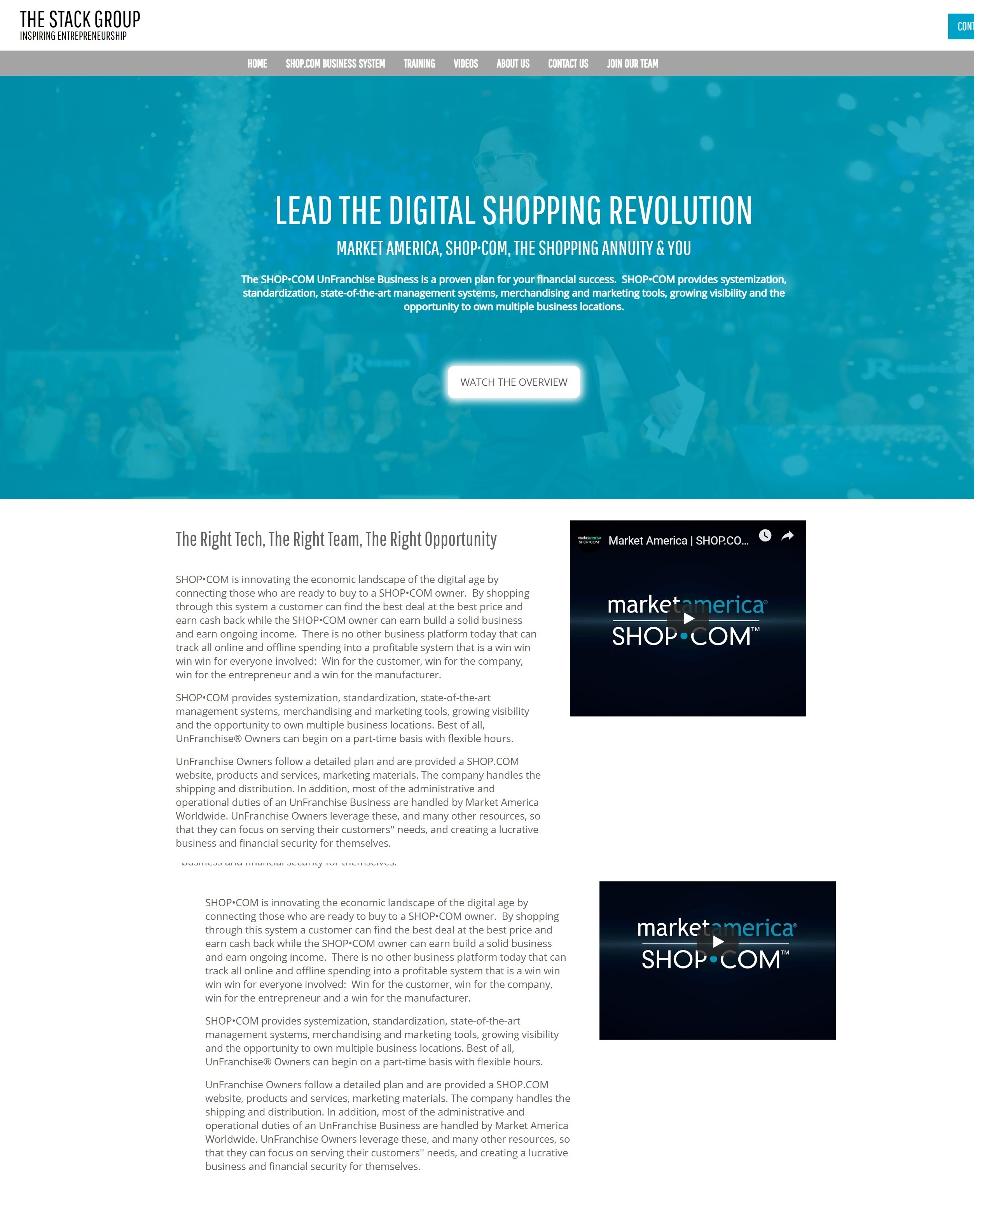
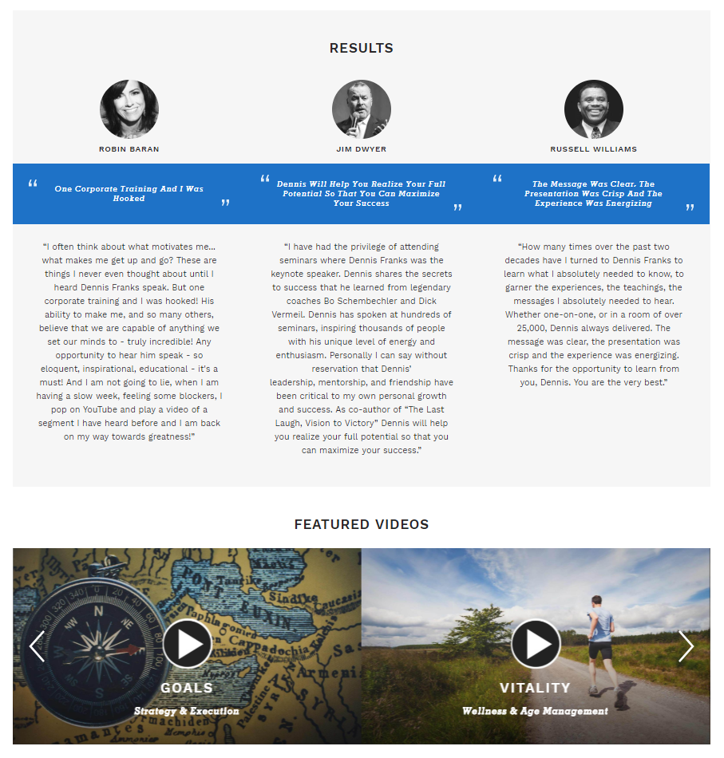
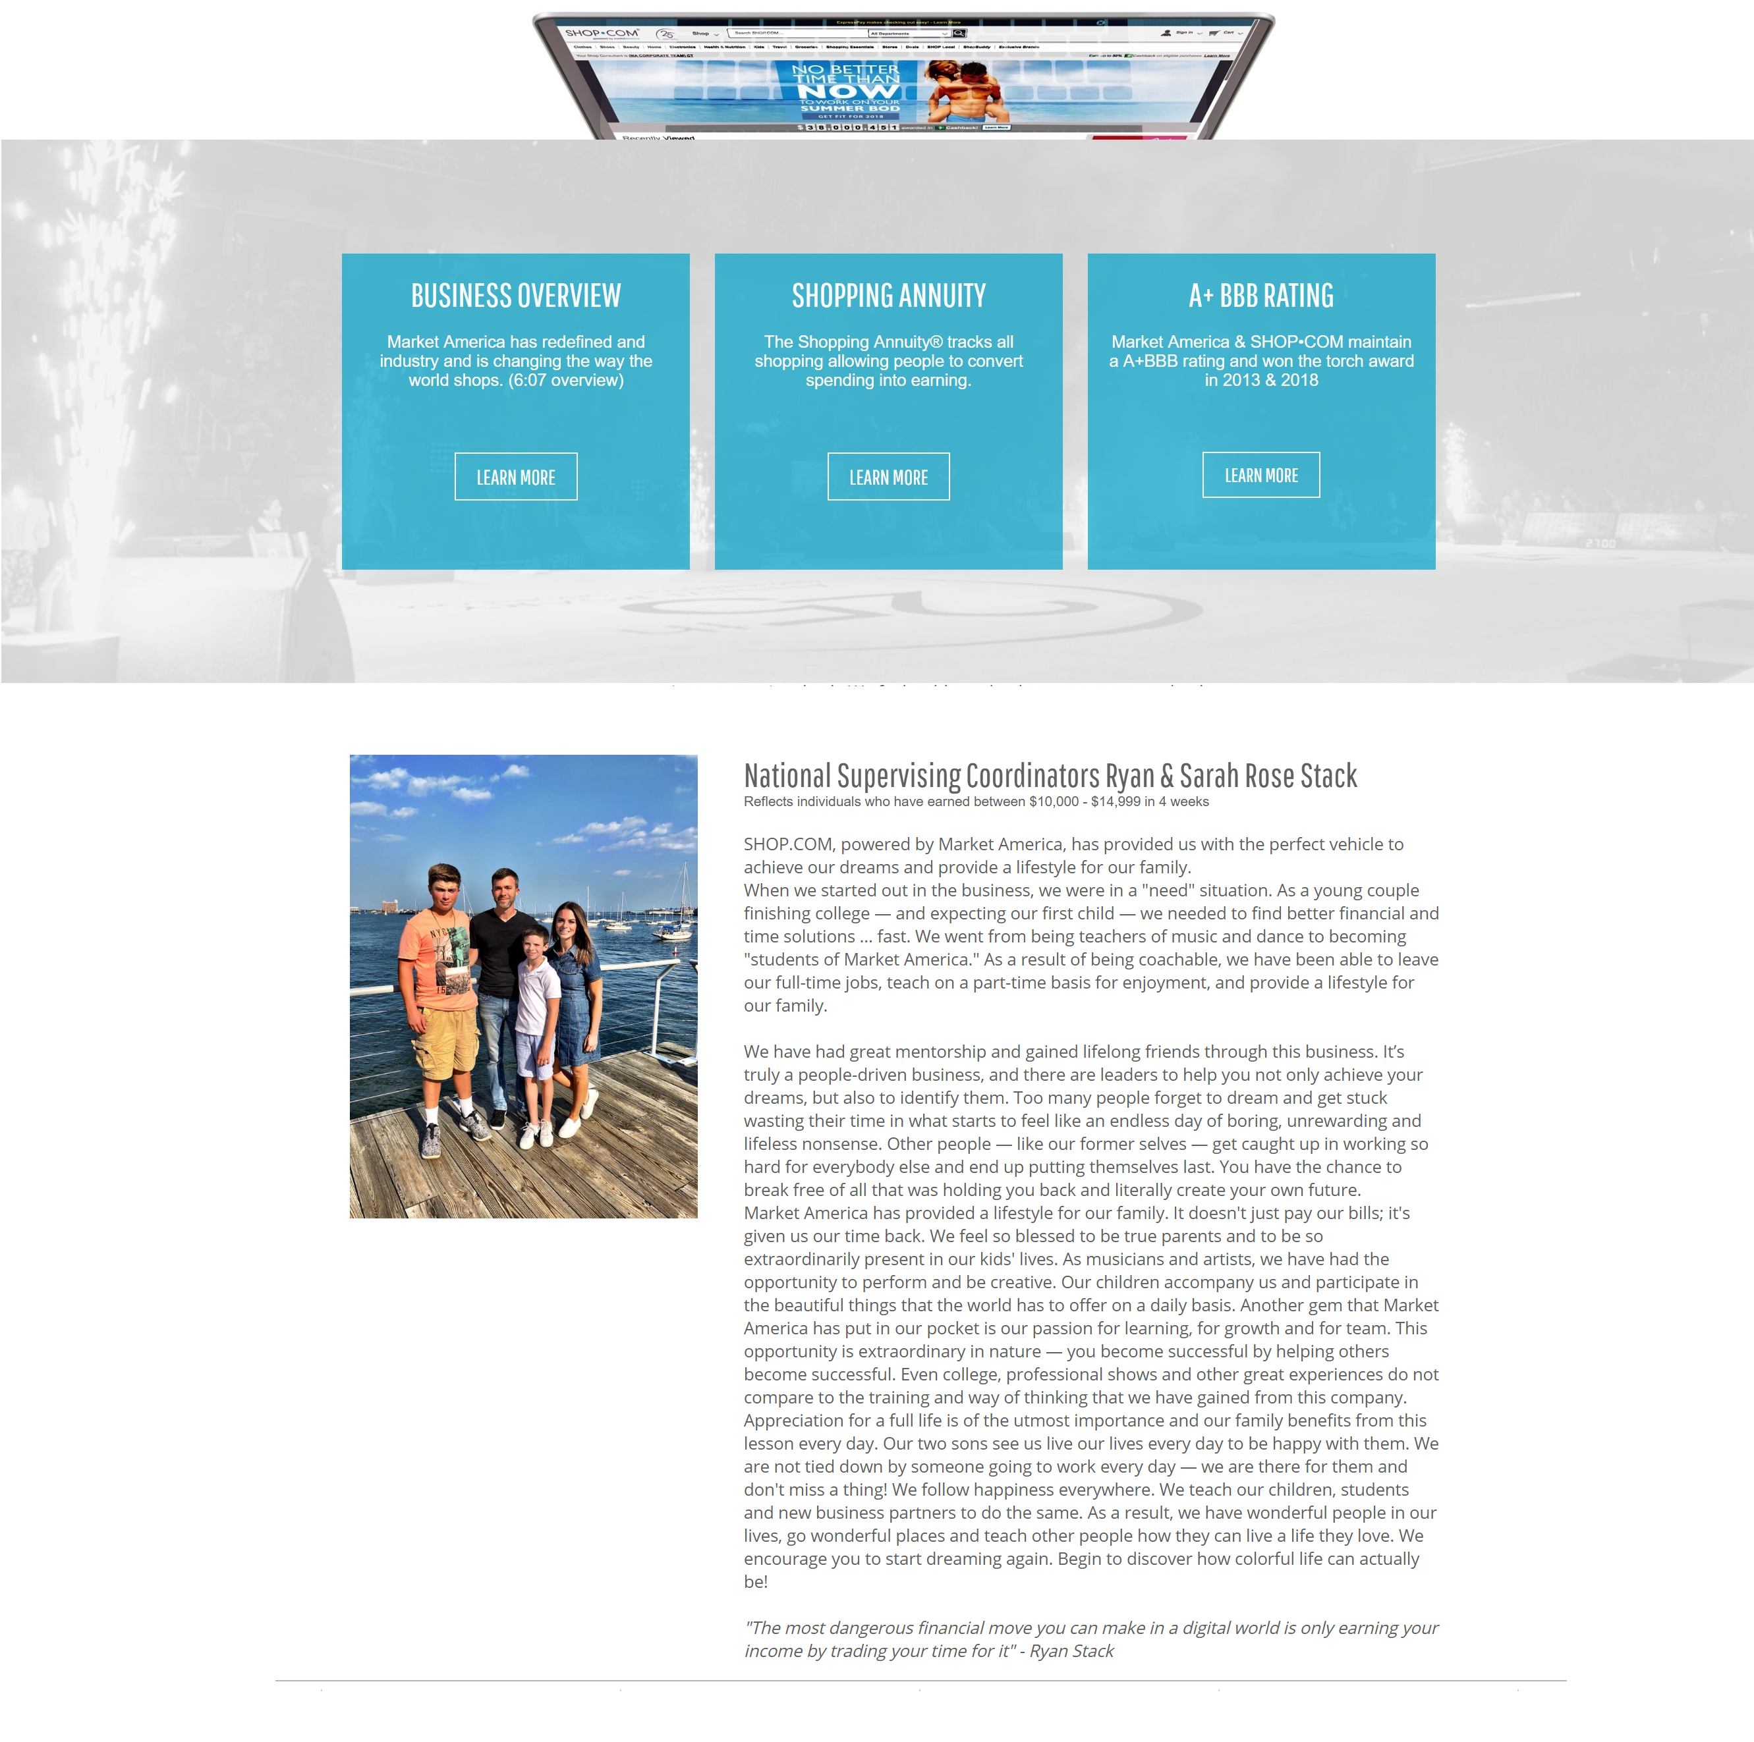
Professional Website / Introductory Page 专业网站 / 简介页

Slide 26
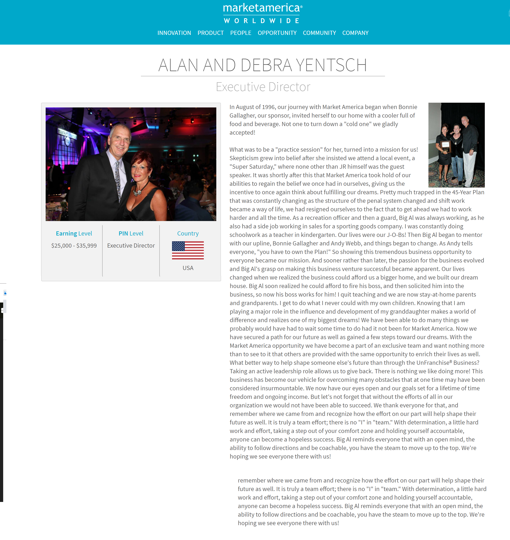

Slide 27
Improving Skillset of Prospecting 提高物色人选的技能
Call Workshop/Text
电话、短讯工作坊
Group Networking
网络小组
Group Social
社群小组

Slide 28
Prospecting - Doing it Right 物色人选 – 做对了！
Stephanie Ng
Supervising Coordinator

